Slide 1
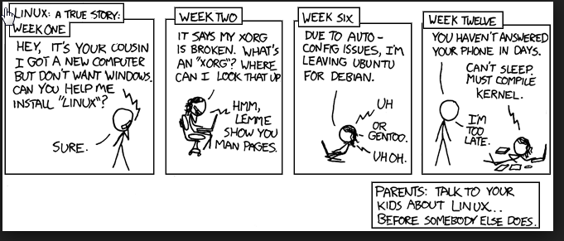
17 F - IT 610101-Systems Administration
Final Project Common Deliverables + Midterm
Individual Deliverables
Avinash Shah

Slide 2
3 Servers
AWS Nagios – Core - http://ec2-52-14-52-143.us-east-2.compute.amazonaws.com/nagios/
AWS MYSQL - ec2-13-59-26-22.us-east-2.compute.amazonaws.com
AWS Apache2 - http://ec2-18-216-245-174.us-east-2.compute.amazonaws.com/

Slide 3
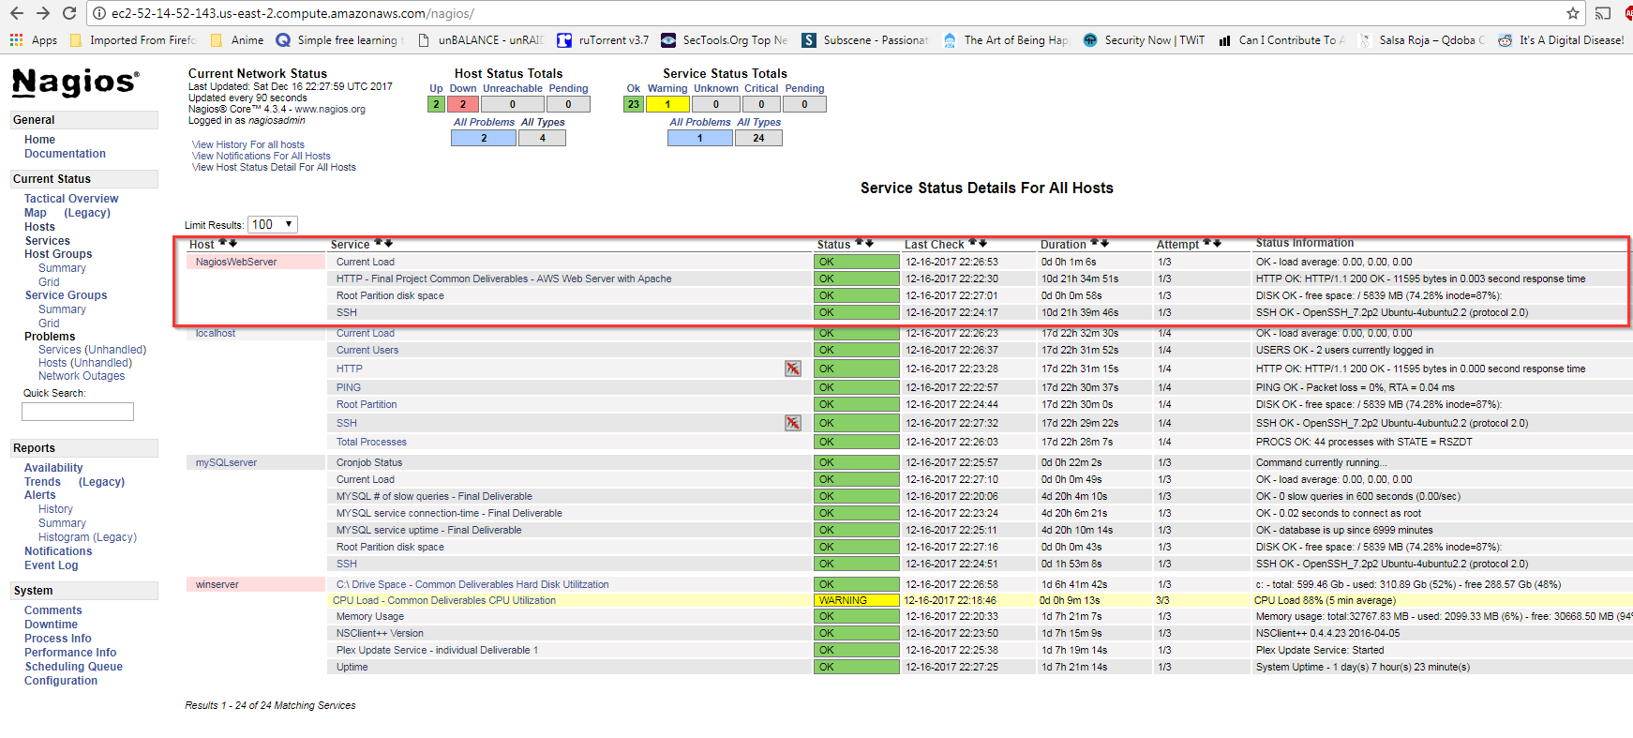
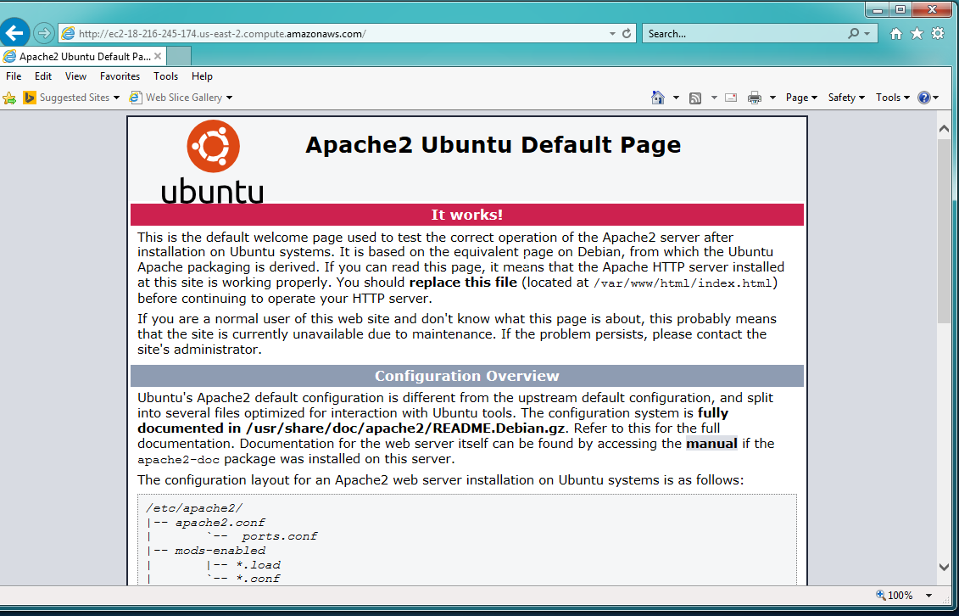
Web Server
Basic Ubuntu web server with Apache2 installed
Nagios NRPE plugin installed to monitor, HTTP, SSH, Root partition, and current load
http://ec2-18-216-245-174.us-east-2.compute.amazonaws.com/

Slide 4
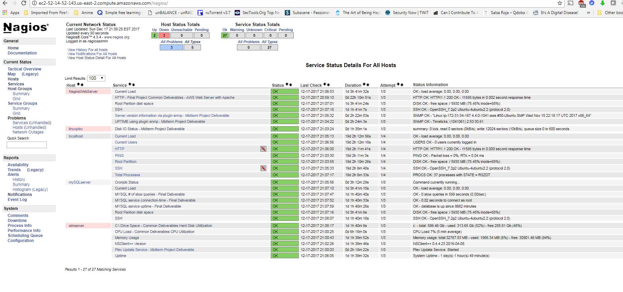
Nagios Server – http://ec2-52-14-52-143.us-east-2.compute.amazonaws.com/nagios/
Basic Ubuntu Box – with Nagios core/plugins/ and specific firewall ports opened

Slide 5
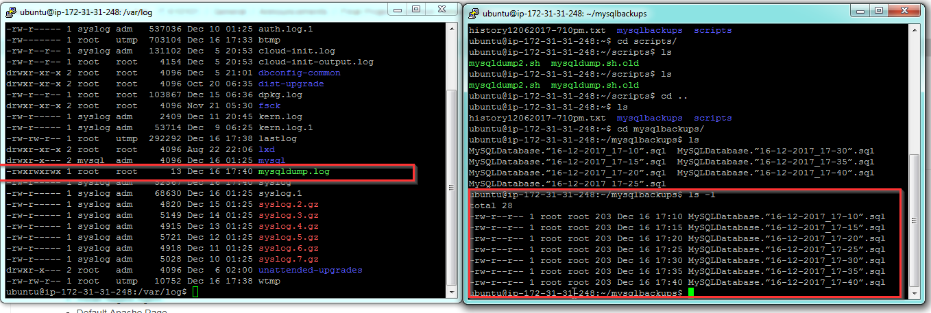
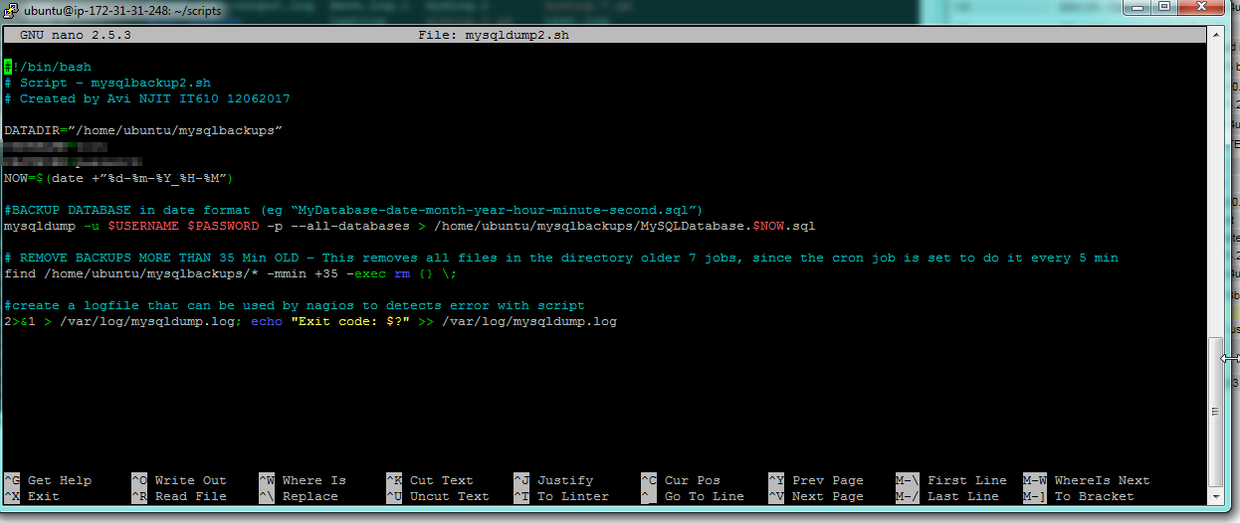
My SQL Database Server
- Basic Ubuntu Box, with mysql installed
- Bash script written to do backup of DB every 5 minutes (delete backups older then 35 min), This then writes to a log file located @ /var/log/mysqldump.log with status
- Nagios Monitors SQL Health through Nagios NPRE on client, and Nagios Plugin
- Nagios Monitors Cronjob , which checks /var/log/mysqldump.log

Slide 6
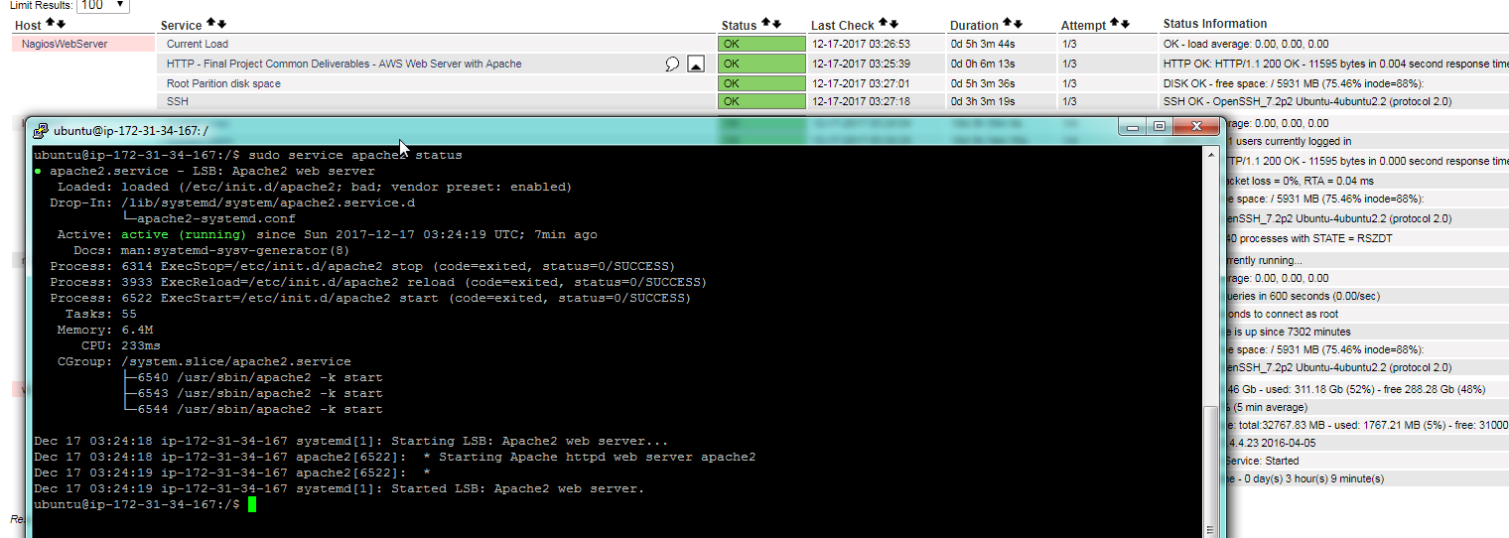
Nagios Push Notifications
- configured email alerts for service failures
- Takes about 7-8 Min for email to arrive
Service in healthy state

Slide 7
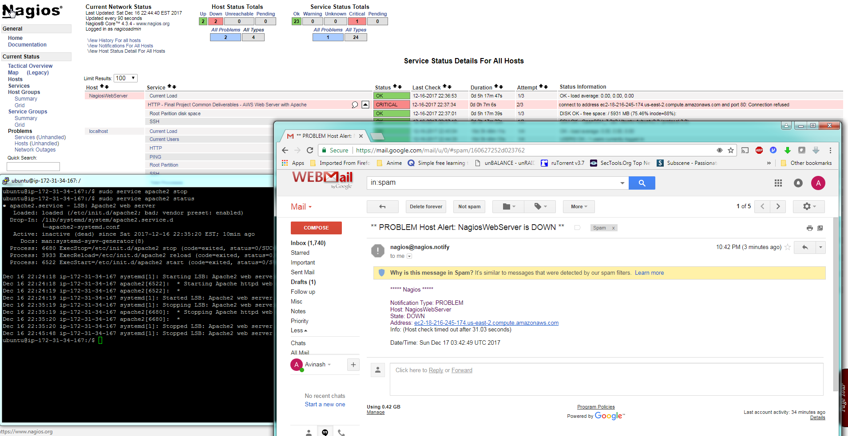
Alert after 7 min once apache2 service disabled

Slide 8

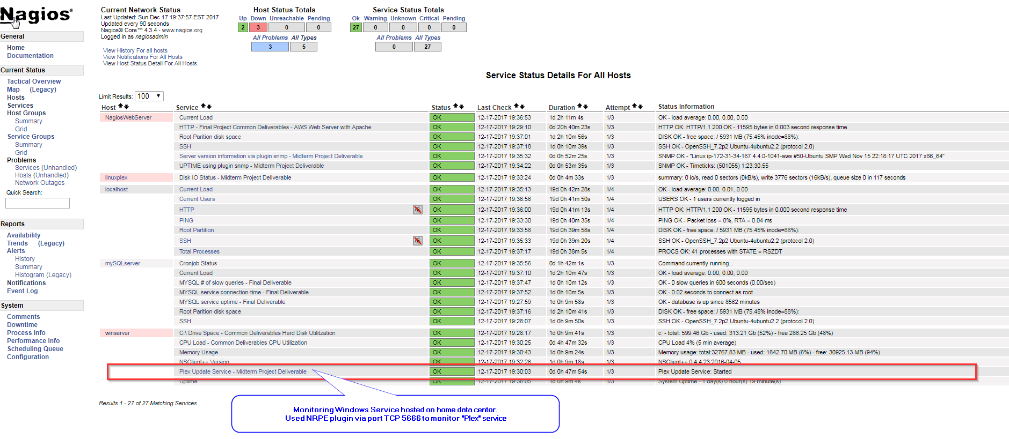
Midterm Project
Individual Deliverables
Monitor Service and Notify for errors

Slide 9
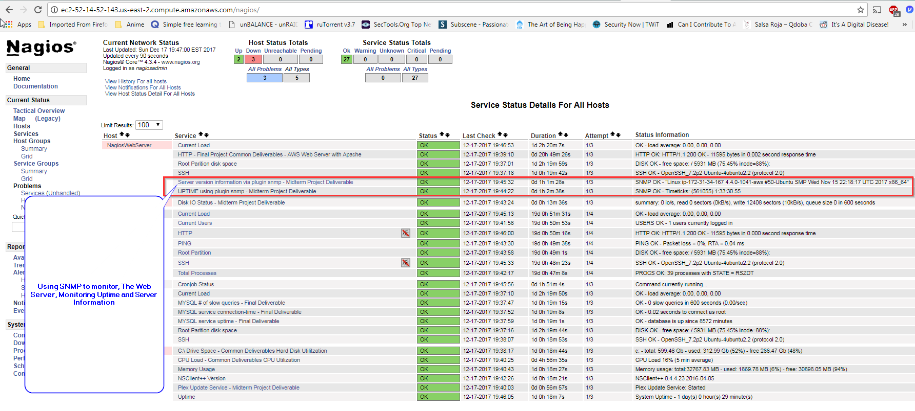
Identity a service that uses SNMP to broadcast its health, configure Nagios to monitor the health of that service properly

Slide 10
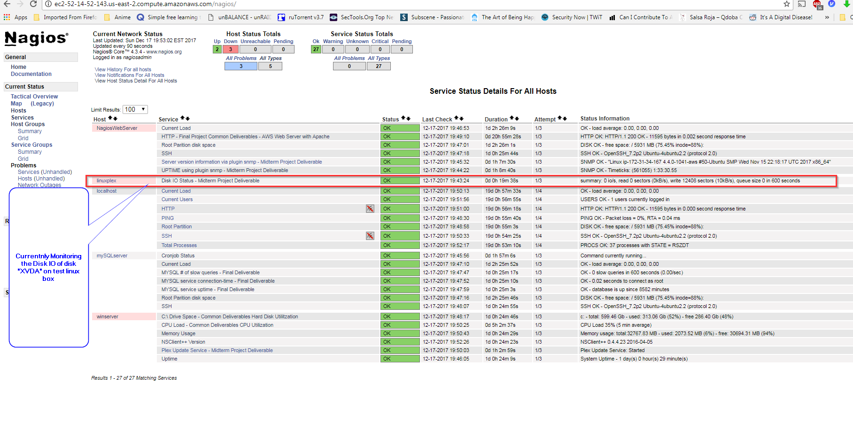
monitor the IO of one of the media servers. Set warning thresholds to alert on them.

Slide 11
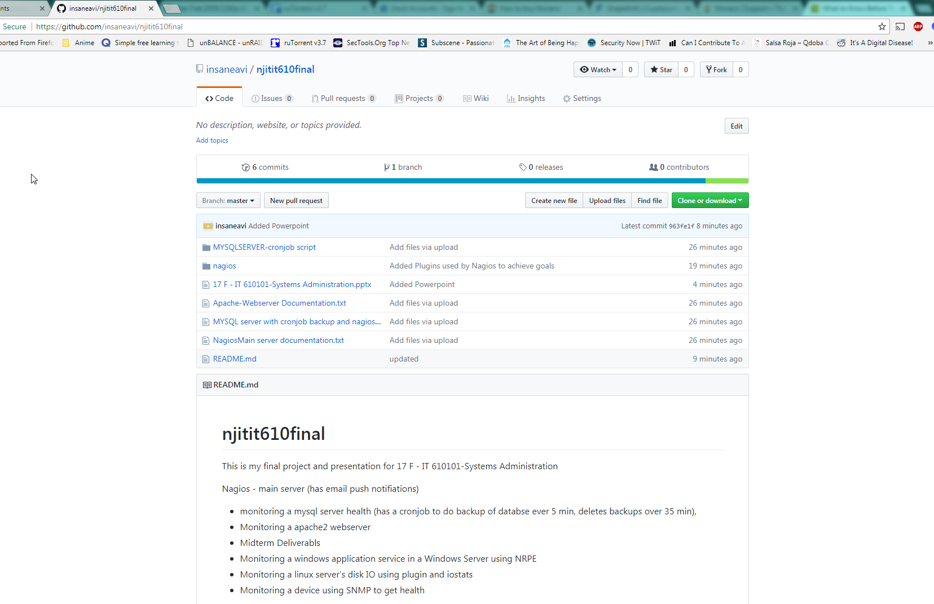
Server Documentation and Scripts
All scripts (cron job for mysql server, Nagios config files and plugins)
Server documentation (how to get servers configured from scratch)
And this powerpoint found @
https://github.com/insaneavi/njitit610final

